Slide 1
Week 5 Sustainable Land Management
Assessing Ecological Impact
Notes:
In this exercise you will be asked to carry out an Ecological Impact Assessment (EcIA) for a hypothetical development project on the fringes of Wimpole Hall Estate. You will need to put together a scoping matrix and then produce an outline of the surveys needed to provide the baseline data that are needed for the full environmental impacts to be assessed.

Slide 2
What does an Environmental Impact Assessment (EIA) involve?
Collects and assesses information on the likely environmental effects of a project in order to:
Allow developers to modify their project design
2) Inform decision makers on whether permission should be granted

Slide 3
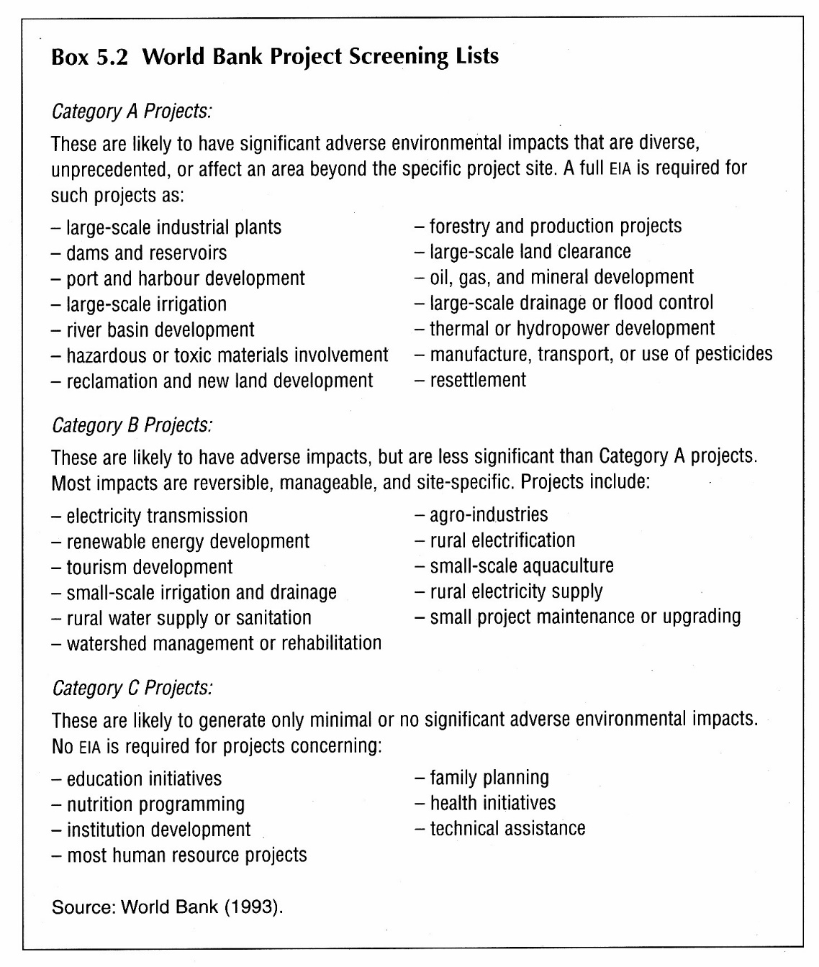

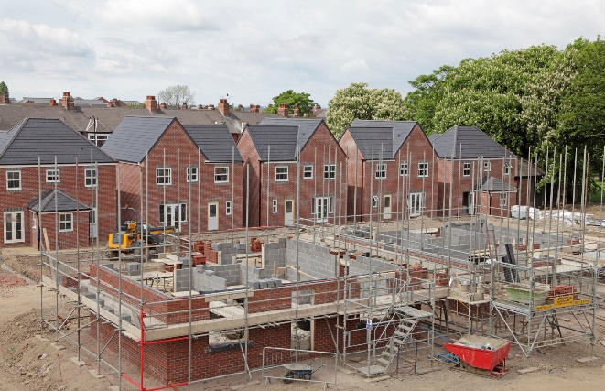
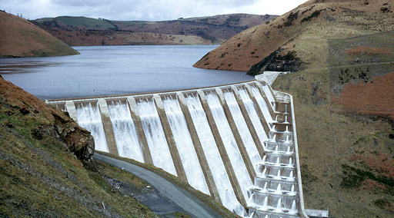
When is an EIA required?
Differs between countries, but World Bank list provides good indication

Slide 4
Where does EIA fit into the planning process?
Is EIA necessary? (screening)
Planning authority
Decide key environmental issues (scoping)
Applicant in consultation
Collect environmental info,
Assess impacts,
Propose measures to deal with impacts (Mitigation)
Applicant
Present Environmental Statement
Applicant
Assess planning application
Planning authority
Monitor site if permission granted
Applicant and Planning authority
Adapted from The Essex guide to EIA, 2007

Slide 5
How does an EIA define the Environment?
Broad multi-interdisciplinary definition:
Ecological (flora and fauna)
Noise
Pollution
Health
Soil quality
Notes:
Ecological Aspects often only relate to 1% of total budget spent on an EIA

Slide 6
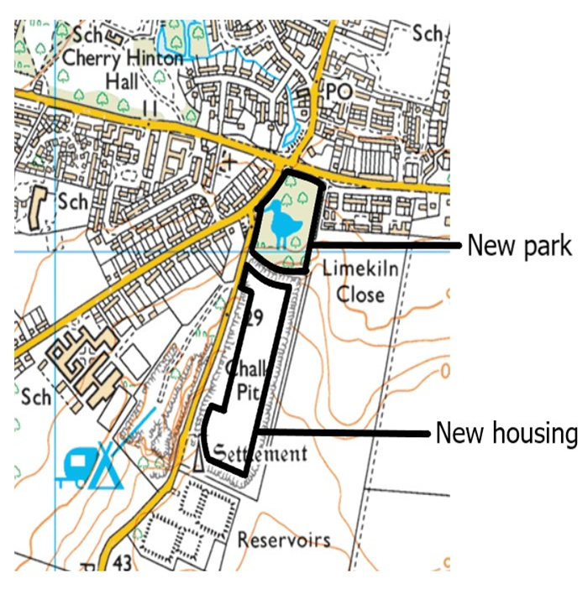
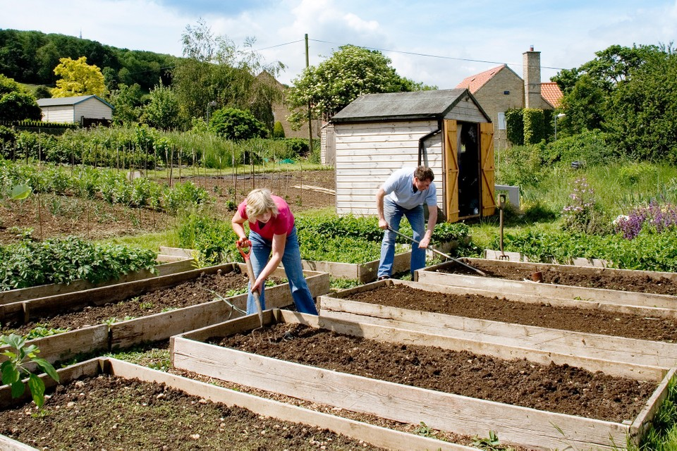
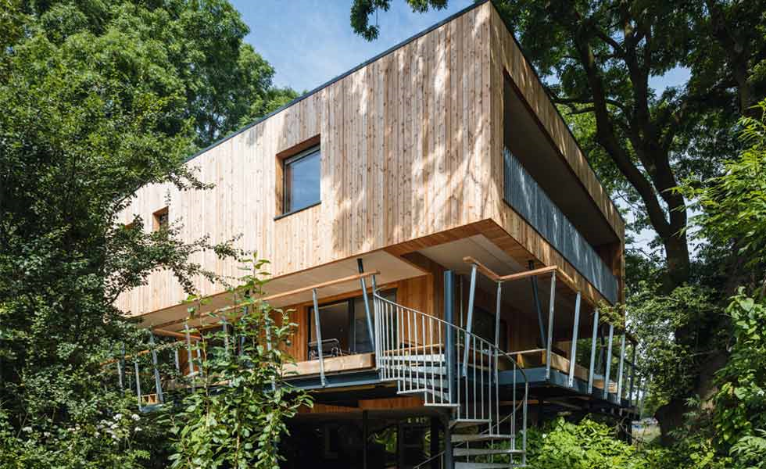
Your assignment requires you to carry out the first stages of an Ecological Impact Assessment (EcIA)
Community Farm
150 Eco-homes
Solar panels, green-walls

Slide 7
Your assignment
Part 1. Establish the ecological value of the development site
Document the habitats and species of interest that have previously been recorded within a 2km-readius of the site
Present the baseline habitat survey of the site (Phase-1 habitat survey)
Part 2. Summarise how the development might impact the ecological value of the site
Part 3. Provide recommendations for further surveys where you feel data is lacking
Notes:
Your are conducting the first stages of an Ecological Impact assessment.

Slide 8
How can we assess ecological impact?
A variety of options:
Experiments and statistical models.
Evidence from comparative studies.
Expert judgement.

Slide 9
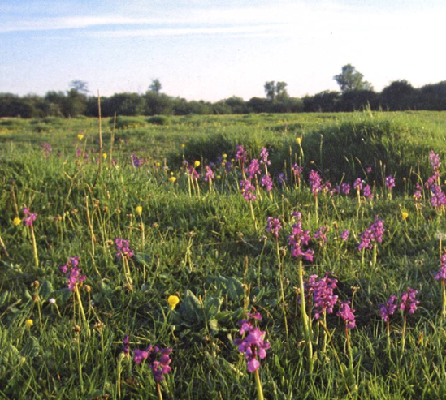
A common approach
Common approach is to use checklist developed by the TAG system (Transport Analysis Guidance) which considers:
Area of features i.e., with key species/habitats/nature reserves
Attributes of the feature (biodiversity/ recreation)
Scale at which it matters (local/national/international)
Importance (designation/rareness)
Trend abundance relative to a target level
Substitution possibilities

Slide 10
Assignment – Part 2: Ecological Impact of the Site Task 3: Scoping matrix (20%) Task 4: Scientific rationale for impact rating (30%)
Next week we will hear about the importance of scientific evidence for decision-making in conservation – the same goes for planning decision.
In this assignment you should be referencing the primary literature.
Notes:
Your are conducting the first stages of an Ecological Impact assessment.

Slide 11
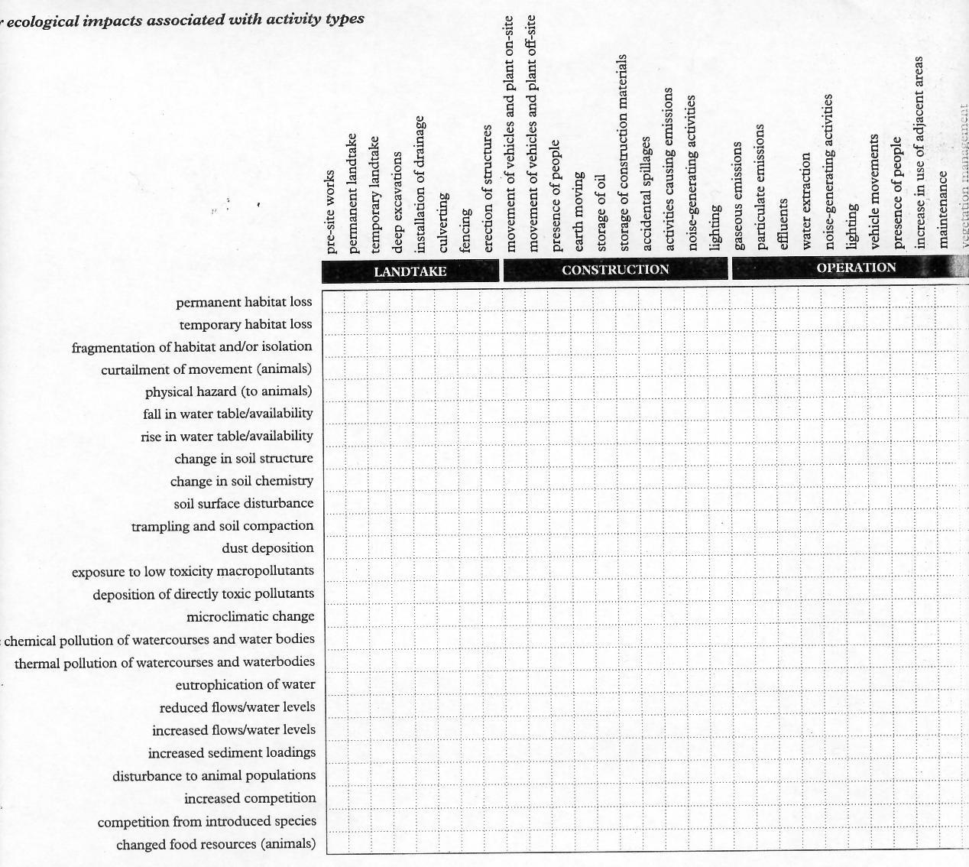
What is a scoping matrix ?
Development actions
Ecological impacts

Slide 12
Indepth scoping can assess ecological impacts at each stage of development.
X
X
X
X
X
X
X

Slide 13
Some impacts likely to be more serious than others – need some form of scaling

Slide 14
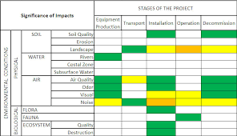
One option is to use a traffic-light system…

Slide 15
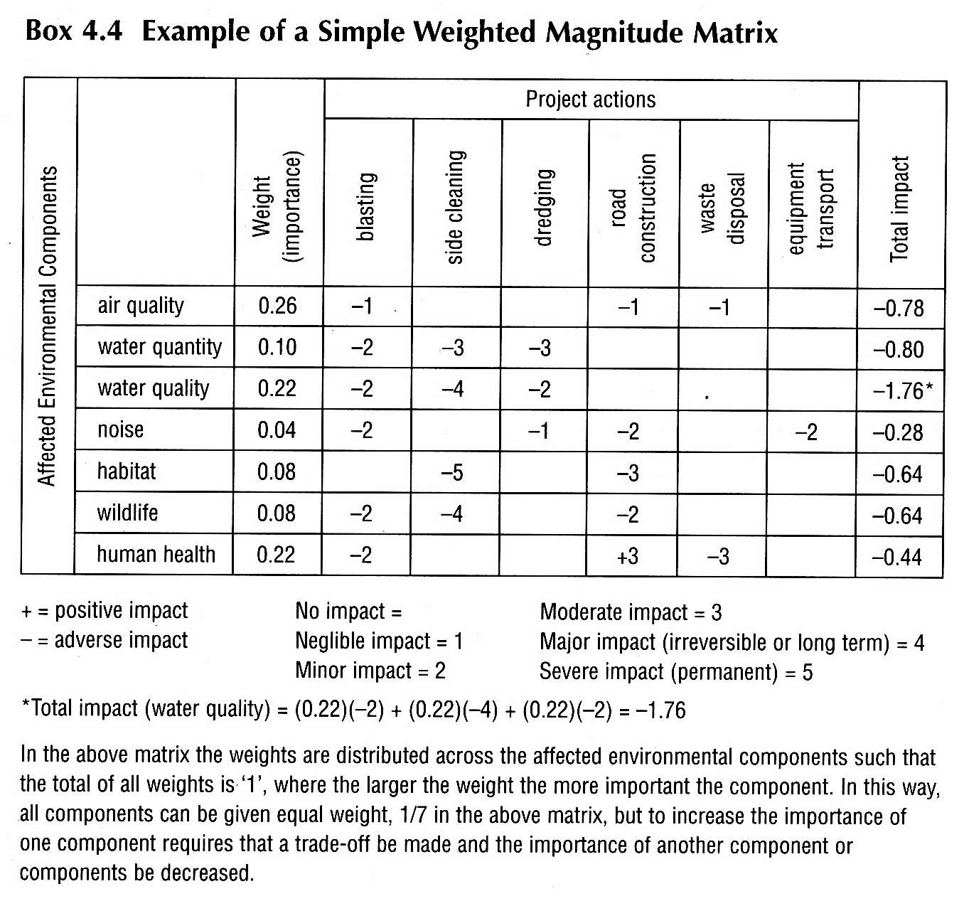
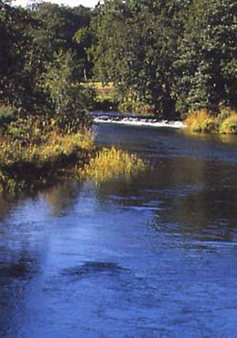
Or to quantify impacts numerically.

Slide 16
Building your own scoping matrix
Include ecological components identified in Part 1 of the assignment.
Rate impacts for at least four stages of development.

Slide 17
Some tips
Consider pooling species into groups, e.g. woodland birds, freshwater. Invertebrates. When justifying your impact scores you can then identify protected species in the text and discuss their ecology, range/extent, national/international importance (Refer back to the TAG checklist).
Where you can, draw on examples from the scientific-literature. Though be aware that examples may be missing for certain species or whole groups of taxa.
Think about the different levels of impact you expect in Lime Kiln Close and East Pits. Do the species/habitats differ in terms of ecological importance? Will impacts differ between the proposed housing development and community farm?

Slide 18
Assignment – Part 3
Task 5: Suggestions for additional data collection (10%)
Is there sufficient information to make a thorough impact assessment?
Consider the following habitats and taxa:
1) Trees/woodland
2) Hedgerows
3) Water bodies
4) Mammals
5) Birds
6) Amphibians and Reptiles.
Be selective – not all these groups will need additional monitoring
Consider available’ information and check current species records. Are they up to date? Are they extensive enough?

Slide 19
Task 5: Suggestions for additional data collection (10%)
Once you’ve decided which information is lacking, suggest and describe the most appropriate/accepted survey protocols needed to collect that data.
Consider aspects such a seasonality.
Do research! (JNCC guidelines will be a good place to start…)

Slide 20
We will spend the rest of the session discussing the likely ecological impacts associated with the proposed eco-village at Cherry Hinton Pits.
Have you found evidence of protected habitats or species?
Do they overlap with the proposed housing or community farm?
How do you think the different stages of development will affect different groups?
Do you require more data (from additional surveys) to make these decisions?

Slide 21
Useful References:
Hill, D et al (2005) Handbook of biodiversity methods. CUP
Institute of Environmental Assessment(1995) Guidelines for baseline ecological assessment.
Institute for Ecology and Environmental Management – Guidelines for ecological impact assessment in the United Kingdom. http://www.ieem.net/ecia/ (on VLE)
Morris, P and Therivel, R (2009) Methods of environmental impact assessment. Routledge.
Noble, B F (2006) Introduction to environmental
impact assessment. OUP
Treweek, J (1999) Ecological impact assessment. Blackwell
http://planningguidance.planningportal.gov.uk/blog/guidance/environmental-impact-assessment/

